Slide 1
Chapter 1: Welcome Aboard
Source:
Introduction to Computing Systems from bits & gates to C & beyond (McGraw-Hill, 2004)
COSC221: Computer Organization I

Slide 2
Topics for Discussion
Introduction to Computer Organization I
  Course goals
  Bottom-Up approach
COSC221: Computer Organization I

Slide 3
Two Recurring Themes
Abstraction
Software vs Hardware
COSC221: Computer Organization I

Slide 4
Important Ideas
#1: All computers, given enough time and memory,
are capable of computing exactly the same things.
#2: Problems are solved through the transformation of spoken language to the voltages that influence the flow of electrons
COSC221: Computer Organization I

Slide 5
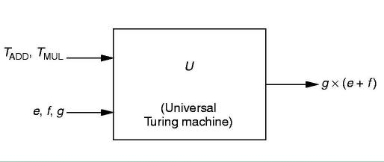
The Turing Machine
Also known as a Universal Computational Device: a theoretical device that accepts both input data and instructions as to how to operate on the data
COSC221: Computer Organization I

Slide 6
The Transformations – Levels of Abstraction
Natural Language
Algorithm
Program
Machine Architecture
Micro-architecture
Logic Circuits
Devices
COSC221: Computer Organization I

Slide 7
Descriptions of Each Level
Problem Statement
  stated using "natural language"
  may be ambiguous, imprecise
Algorithm
  step-by-step procedure, guaranteed to finish
  definiteness, effective computability, finiteness
Program
  express the algorithm using a computer language
  high-level language, low-level language
Instruction Set Architecture (ISA)
  specifies the set of instructions the computer can perform
  data types, addressing mode
COSC221: Computer Organization I

Slide 8
Descriptions of Each Level (cont.)
Microarchitecture
  detailed organization of a processor implementation
  different implementations of a single ISA
Logic Circuits
  combine basic operations to realize microarchitecture
  many different ways to implement a single function
  (e.g., addition)
Devices
  properties of materials, manufacturability
COSC221: Computer Organization I

Slide 9
Reading Assignment
Chapter 2 Bits, Data Types, and Operations
COSC221: Computer Organization I

